Slide 1
Team Captain Instructions

Slide 2
1. Begin by going to: http://walkacrosstexas.tamu.edu/ 2. Click Register Now. All teams will begin a completely new account for 2016.

Slide 3
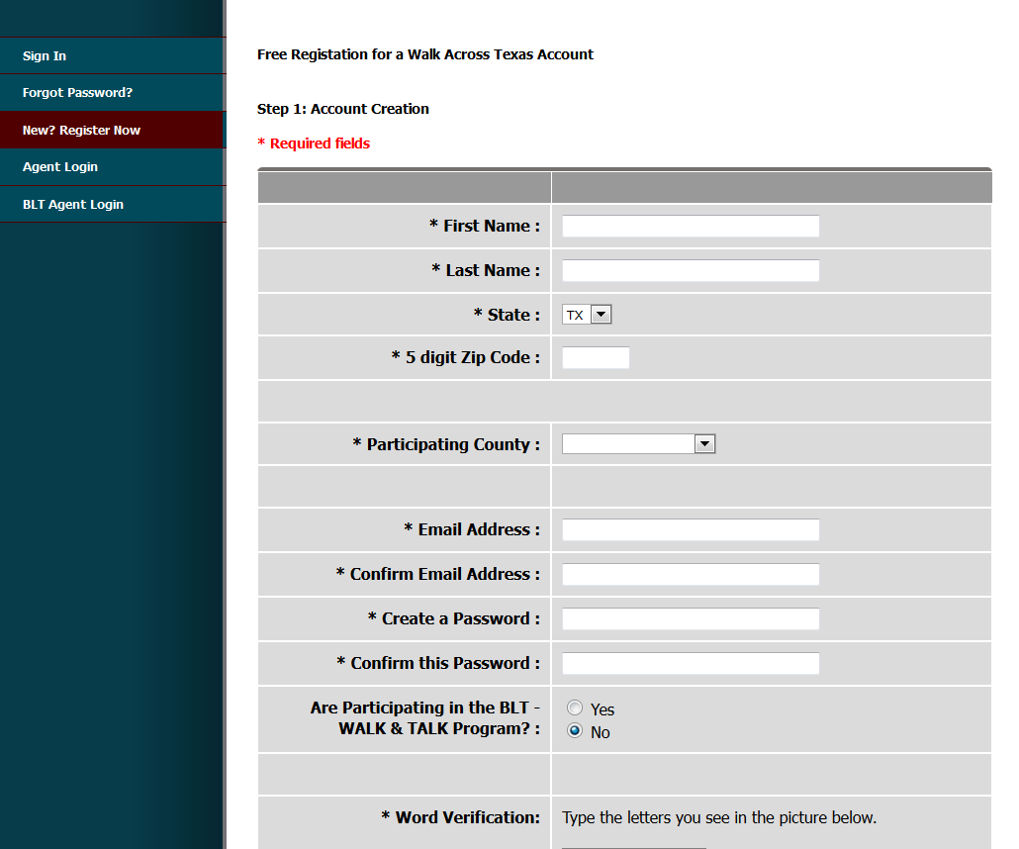
3. Step 1: Account Creation - Fill out the requested information completely. *Participating County will be the one in which your worksite is in. Press I Accept. Continue.

Slide 4
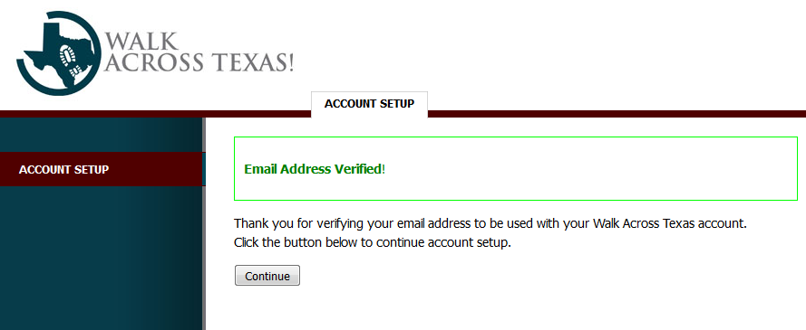
4. You will receive a confirmation email. Please check your email and click the link provided.
5. You will be redirected to an Account Setup page asking you to Continue

Slide 5
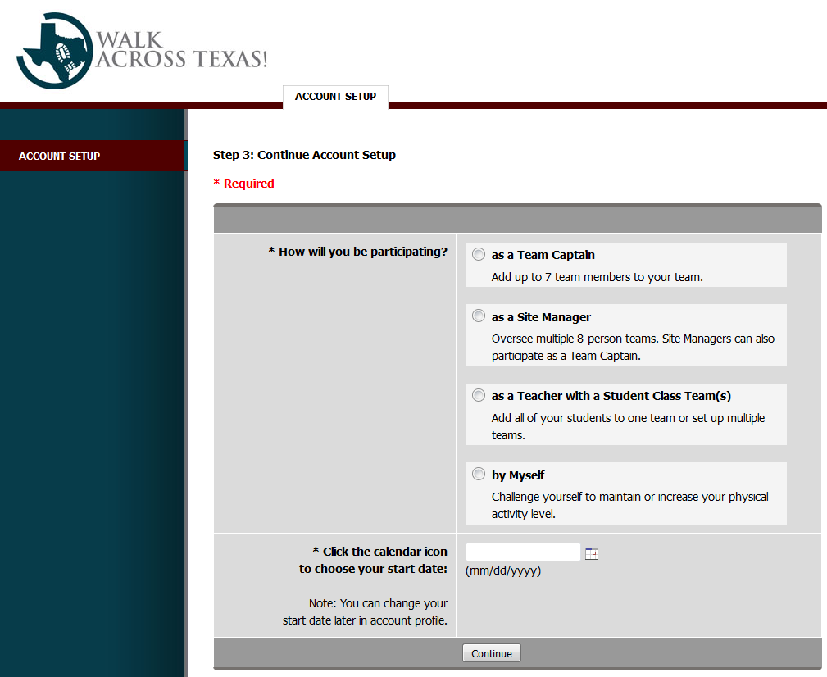
6. Step 3: Continue Account Setup 7. You will register as a Team Captain. 8. Start date will be 01/09/2017 9. Press Continue

Slide 6
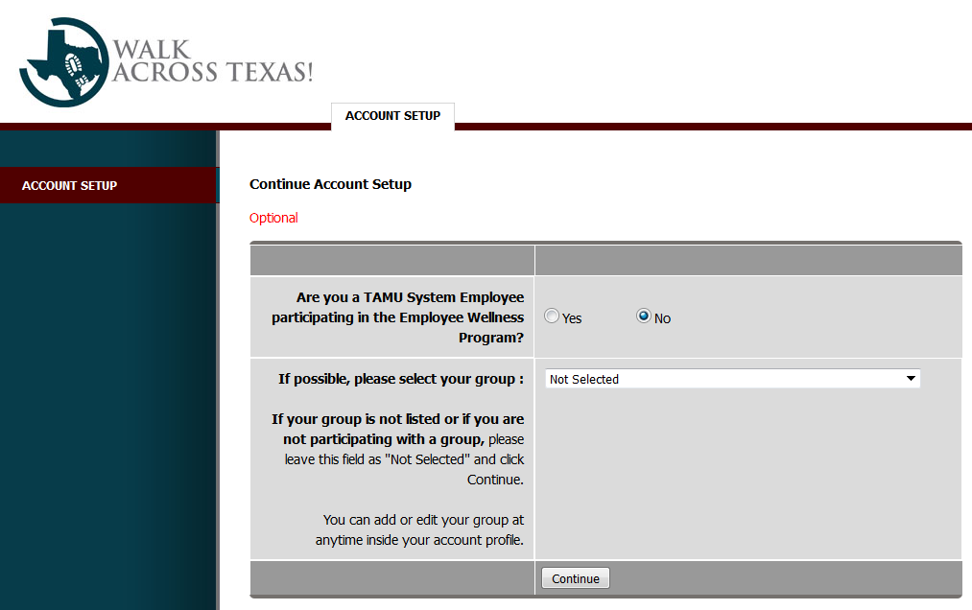
10. Select your group: This will be whichever group fits your team best. 11. Click Continue.

Slide 7
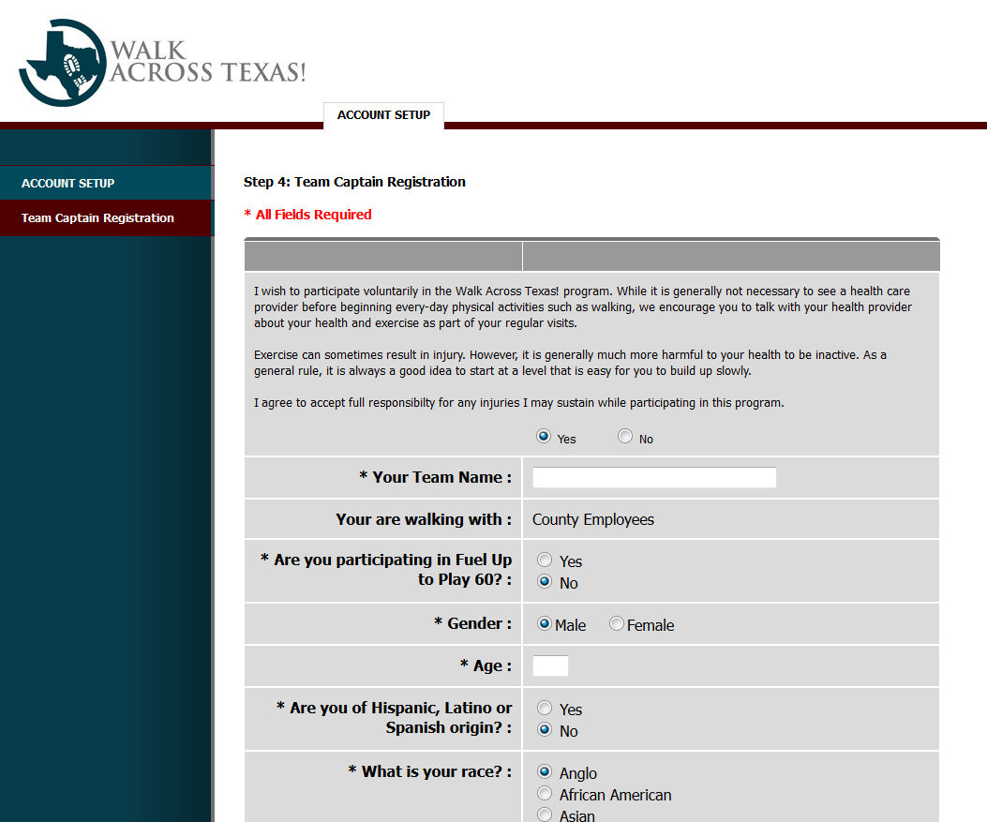
12. Step 4: Team Captain Registration – Begin by typing the Team Name. Fill out the remainder of the form answering the questions for yourself. 13. At the bottom click Register as Captain.

Slide 8
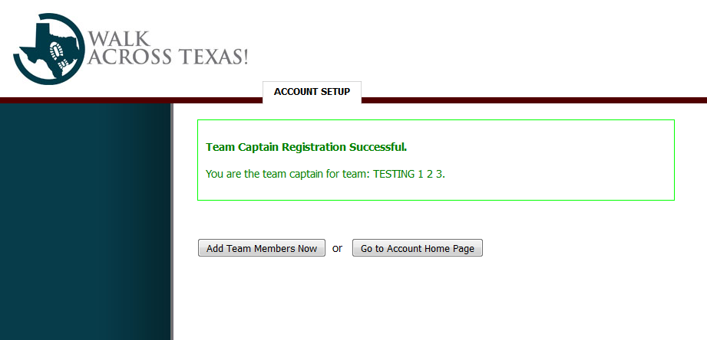
14. You will now be ready to Add Team Members Now.
15. All team members must complete the Individual Registration Form before you can add them to your team. Continue adding team members until your team is complete with a total of 8 members.

Slide 9
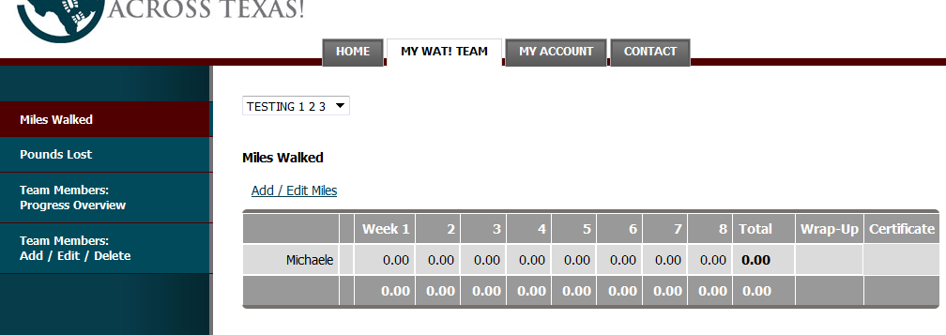
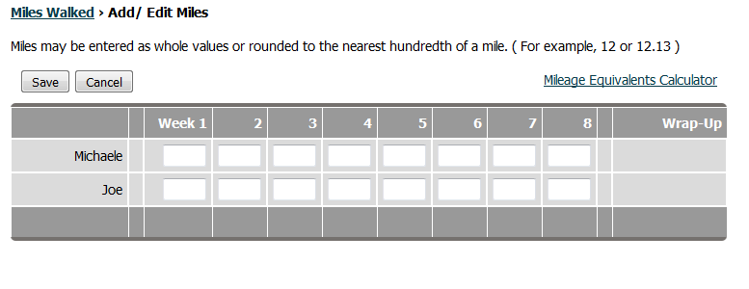
16. To enter Miles Walked, look on the left hand bar and click on Miles Walked. 17. Click Add/Edit Miles – All team members will show. Update miles.
18. After entering miles for each member, click Save.

Slide 10
“Texas A&M AgriLife Extension provides equal opportunities in its programs and employment to all persons, regardless of race, color, sex, religion, national origin, disability, age, genetic information, veteran status, sexual orientation, or gender identity. Persons with disabilities who plan to attend this event and who may need accommodations are required to contact Texas A&M AgriLife Extension Service at 979.864.1558 five working days prior to the meeting so appropriate arrangements can be made. The Texas A&M University System, U.S. Department of Agriculture, and the County Commissioners Courts of Texas Cooperating.”

